Slide 1
Immersive Python Workshop
Day 3
Data Visualization
8/14/2026

Slide 2
Overall Goals of this Data Visualization Session
See examples of what’s possible
Learn benefits of scripting data visualization tasks
Learn how to read documentation about using Python packages
Get familiar with the process of developing Python scripts locally

Slide 3
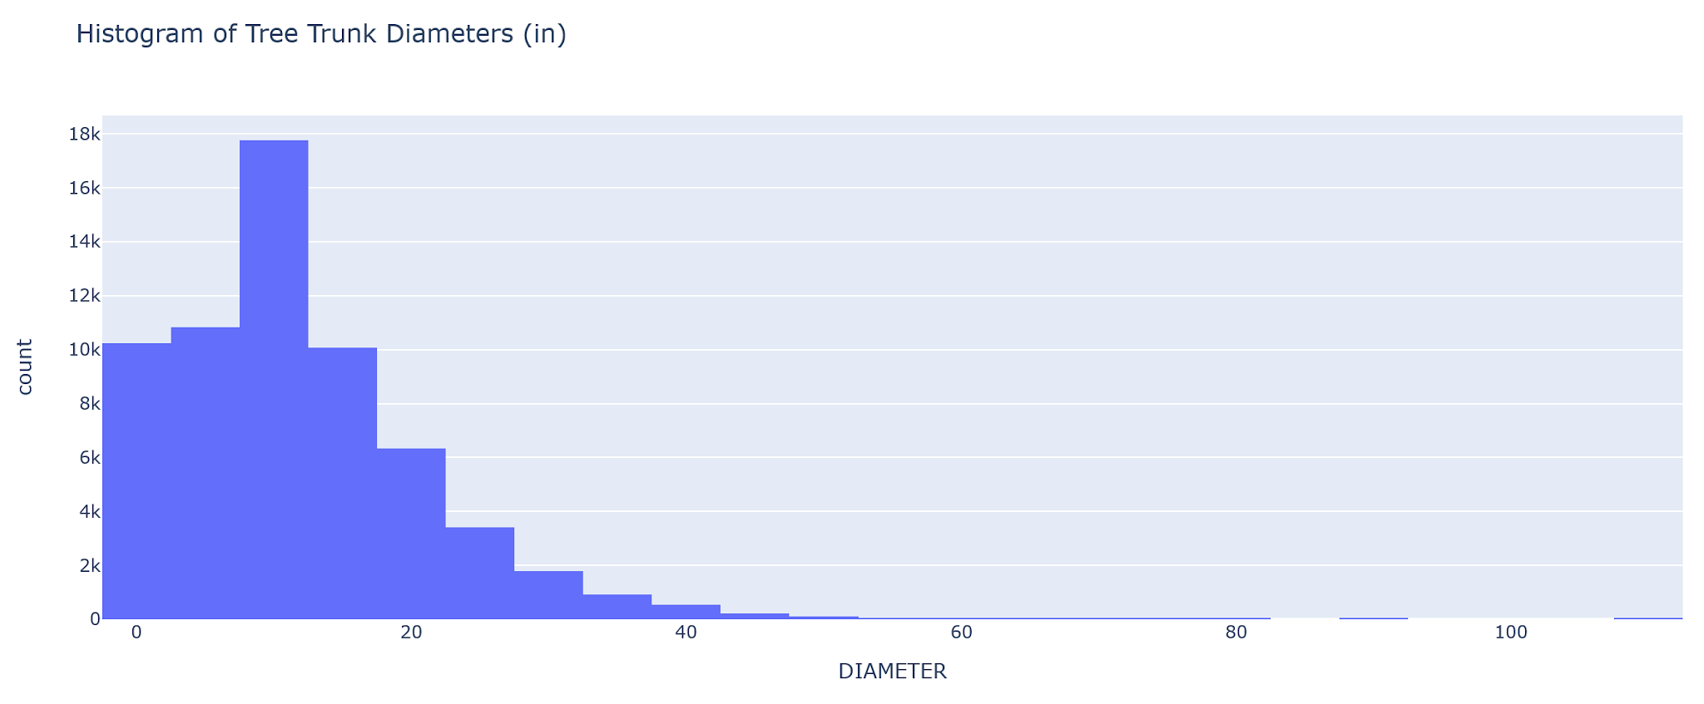
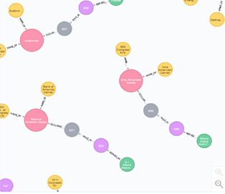
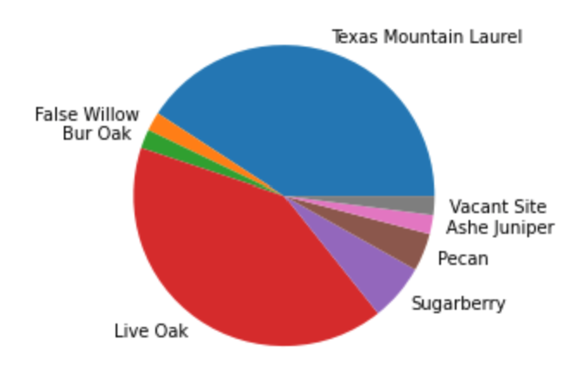
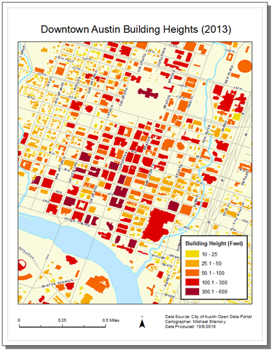
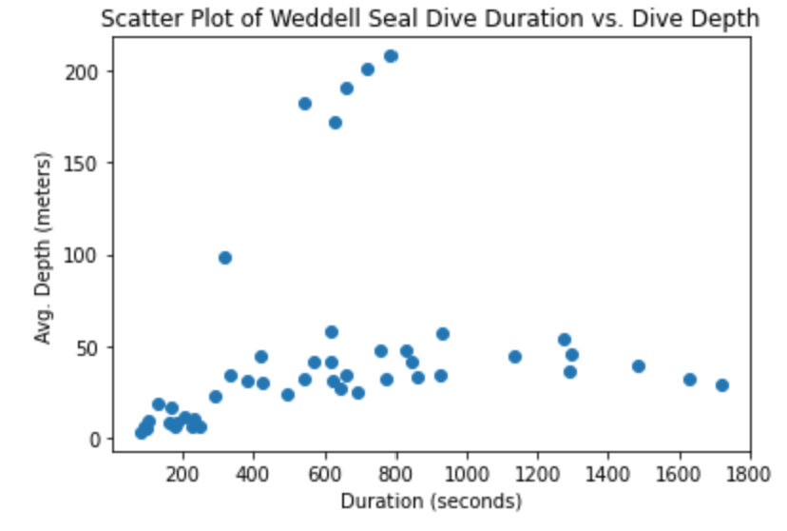
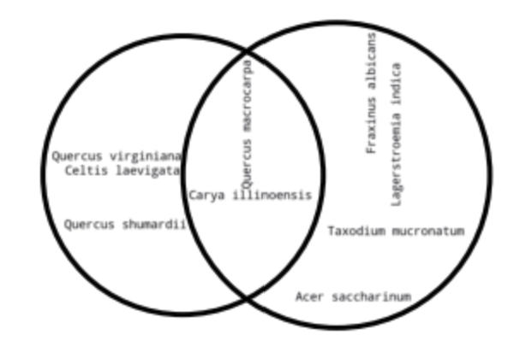
What is Data Visualization?
Graphically representing data to facilitate communication of information
Visualizations often take the form of charts, graphs, maps, and diagrams
Effective data visualization is both an art and science
Can be difficult and time consuming when:
Datasets are large and complicated
Datasets are updated frequently
Large numbers of visualizations need to be created
Multiple styles of a visualization product are required for different audiences

Slide 4
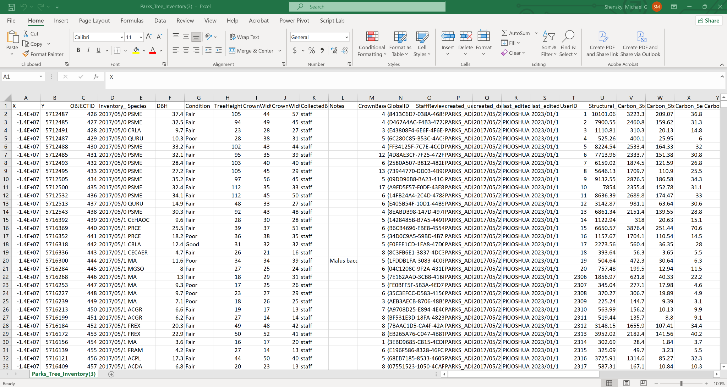
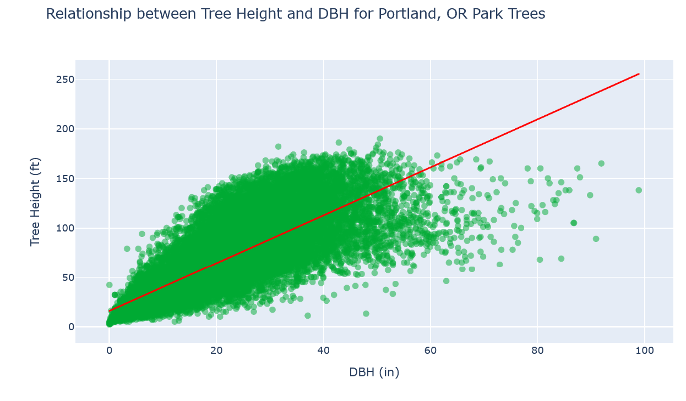
Raw Data vs. Visualized Data

Slide 5
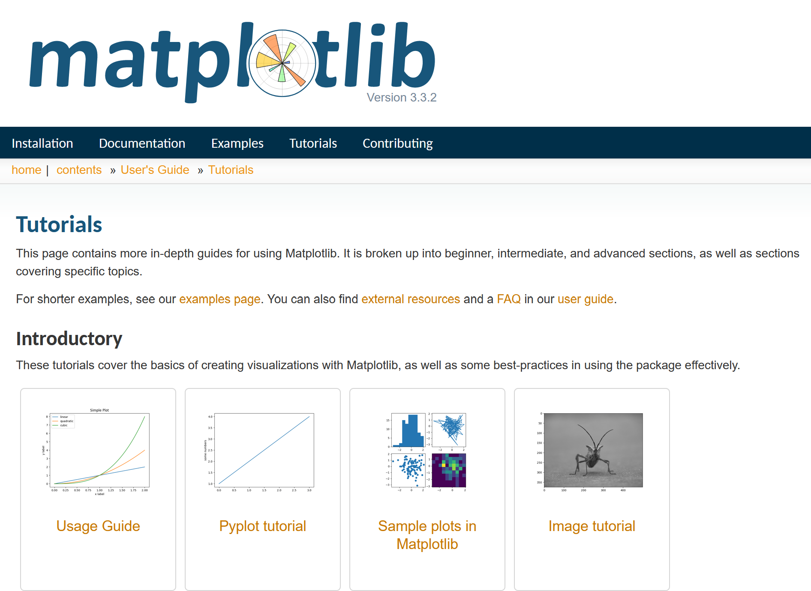
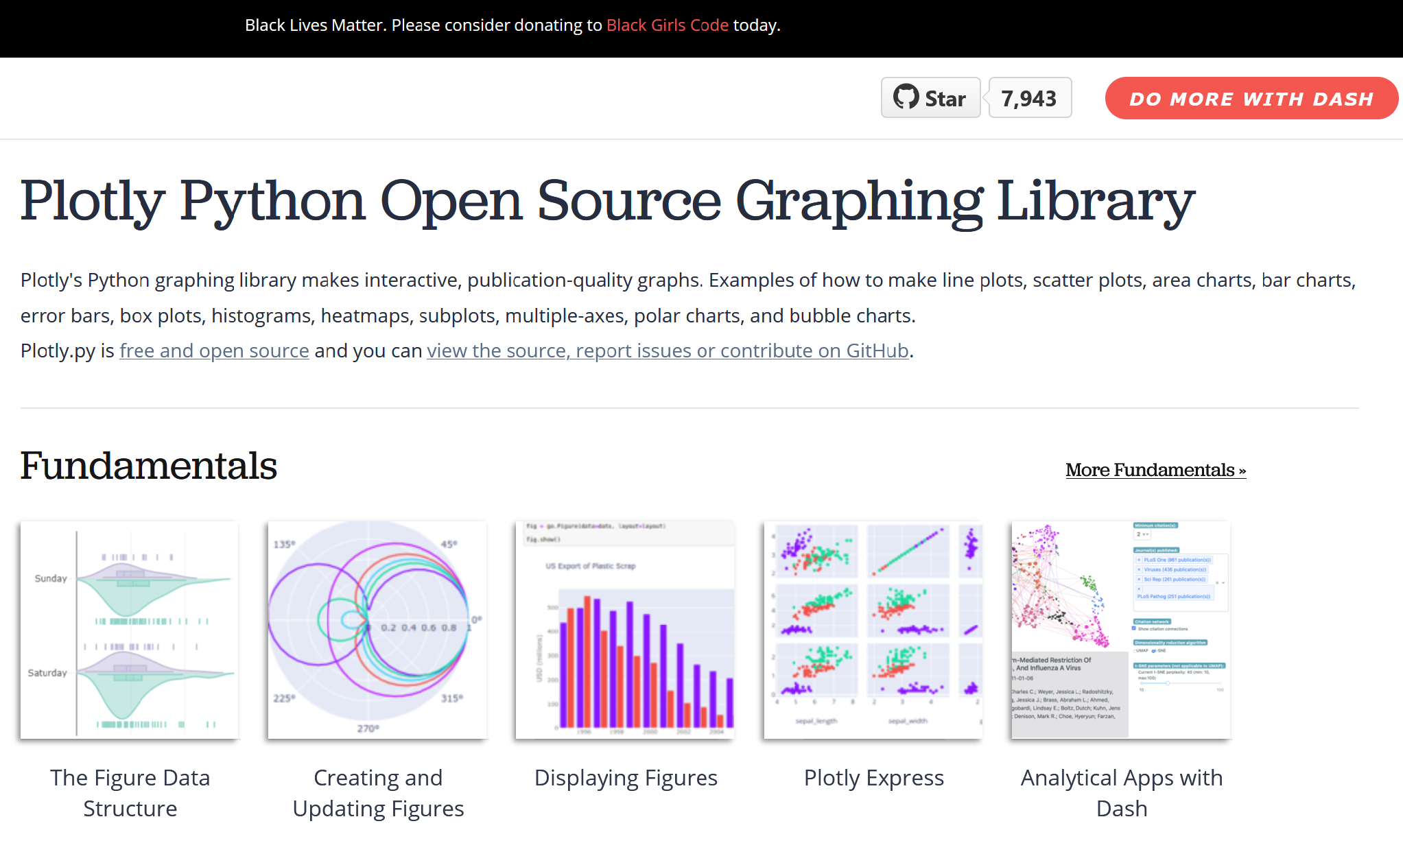
Python Data Visualization Resources
Matplotlib Documentation (https://matplotlib.org/3.3.2/tutorials/index.html)
Altair Documentation (https://altair-viz.github.io/user_guide/data.html)
Plotly Documentation (https://plotly.com/python/)

Slide 6






Choosing a Data Visualization Library
Factors to Consider
Static vs interactive visualizations
Support for niche visualization types (e.g. maps, networks)
Popularity
API level of control
API documentation

Slide 7


Packages for Tabular Data and Data Visualization
Commonly used packages
Pandas
Polars

Slide 8

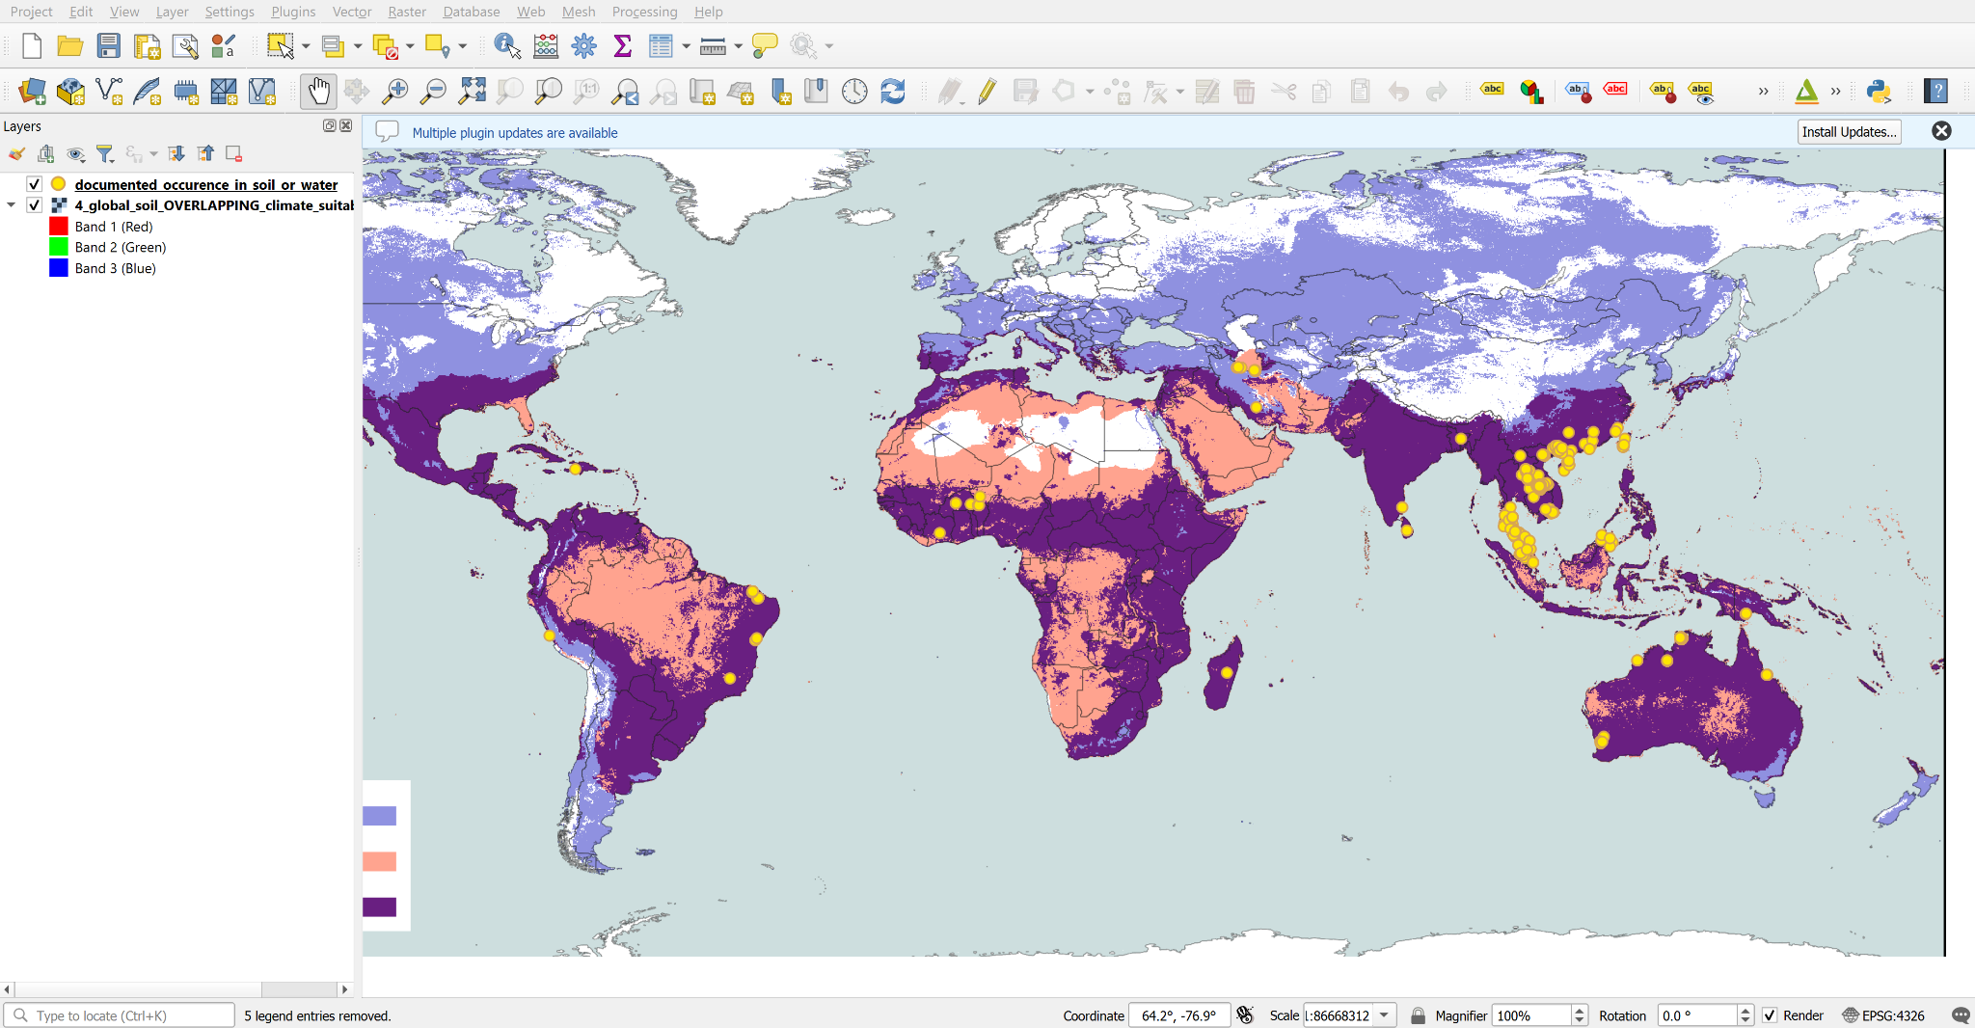


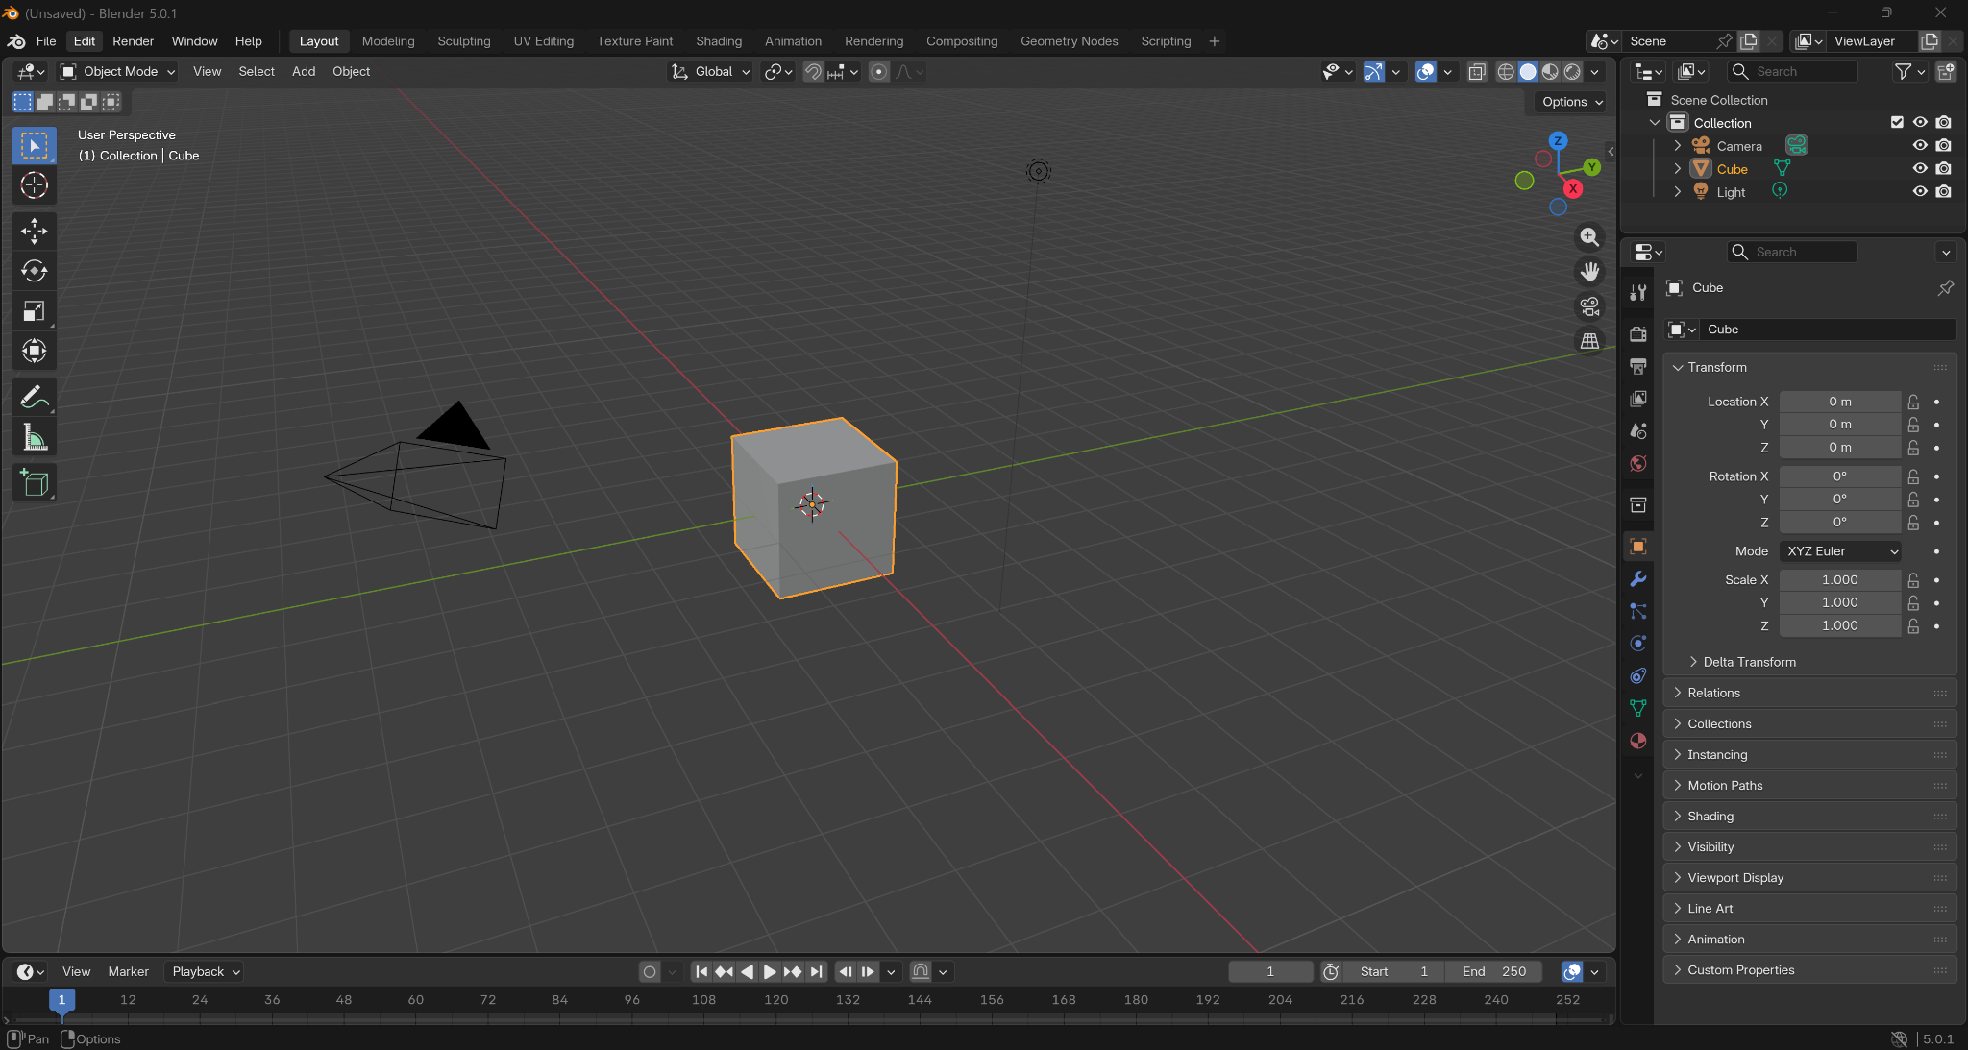
Python for Automating Processes in Data Vis Desktop Software
Software with Python APIs
Blender (3D visualization)
ArcGIS Pro (Spatial visualization)
QGIS (Spatial visualization)

Slide 9
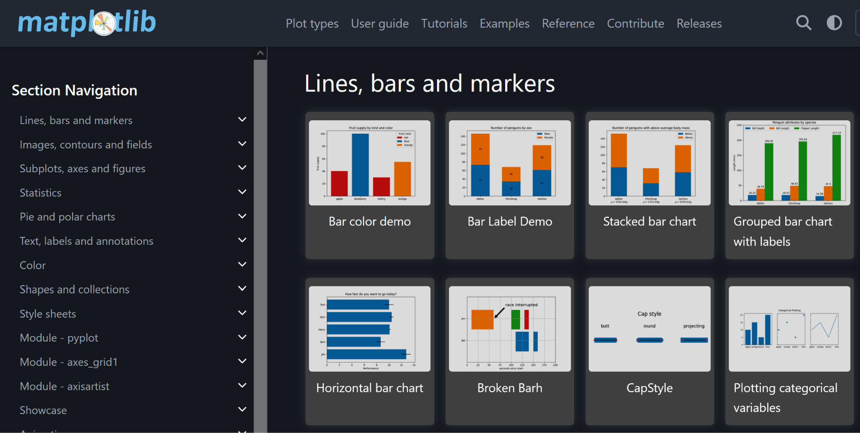
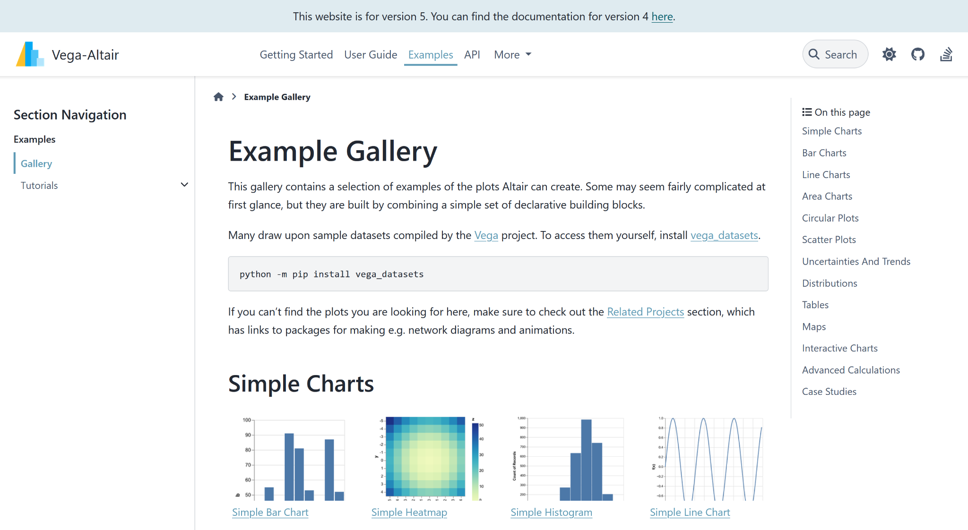
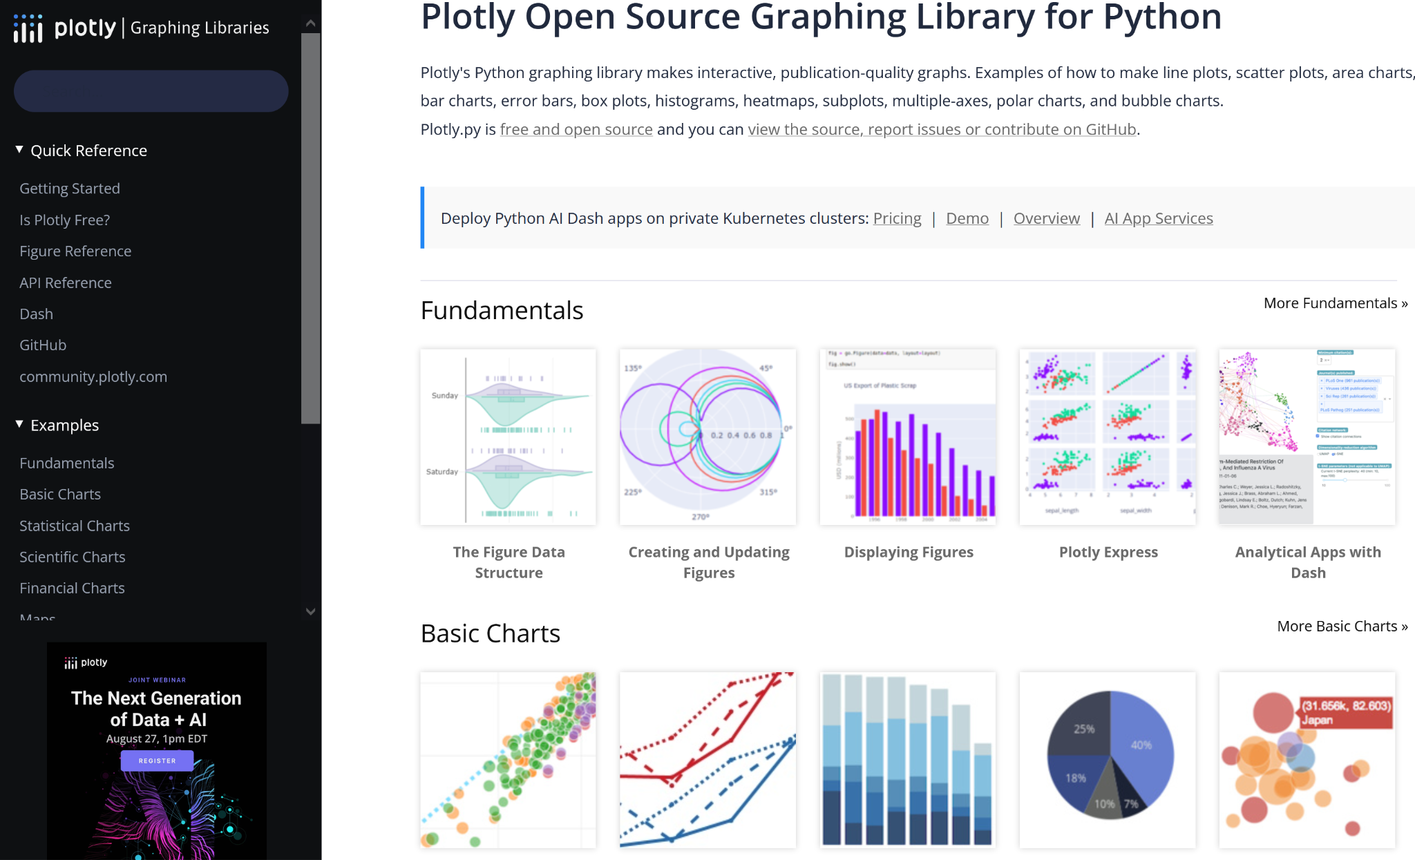
Learn What’s Possible and Get Ideas
Python Data Vis Package Galleries to Visit
NetworkX https://networkx.org/documentation/stable/auto_examples/
Plotly https://plotly.com/python/
Matplotlib https://matplotlib.org/stable/gallery/
Seaborn https://seaborn.pydata.org/examples/
Altair https://altair-viz.github.io/gallery/

Slide 10
Good Data Visualization Practices
Design for your audience
Consider providing captions
Think about aesthetics
Consider accessibility best practices
Be sure to include essential information
Title
Labeled axes
Specify units for numeric values
Legend (if applicable)

Slide 11
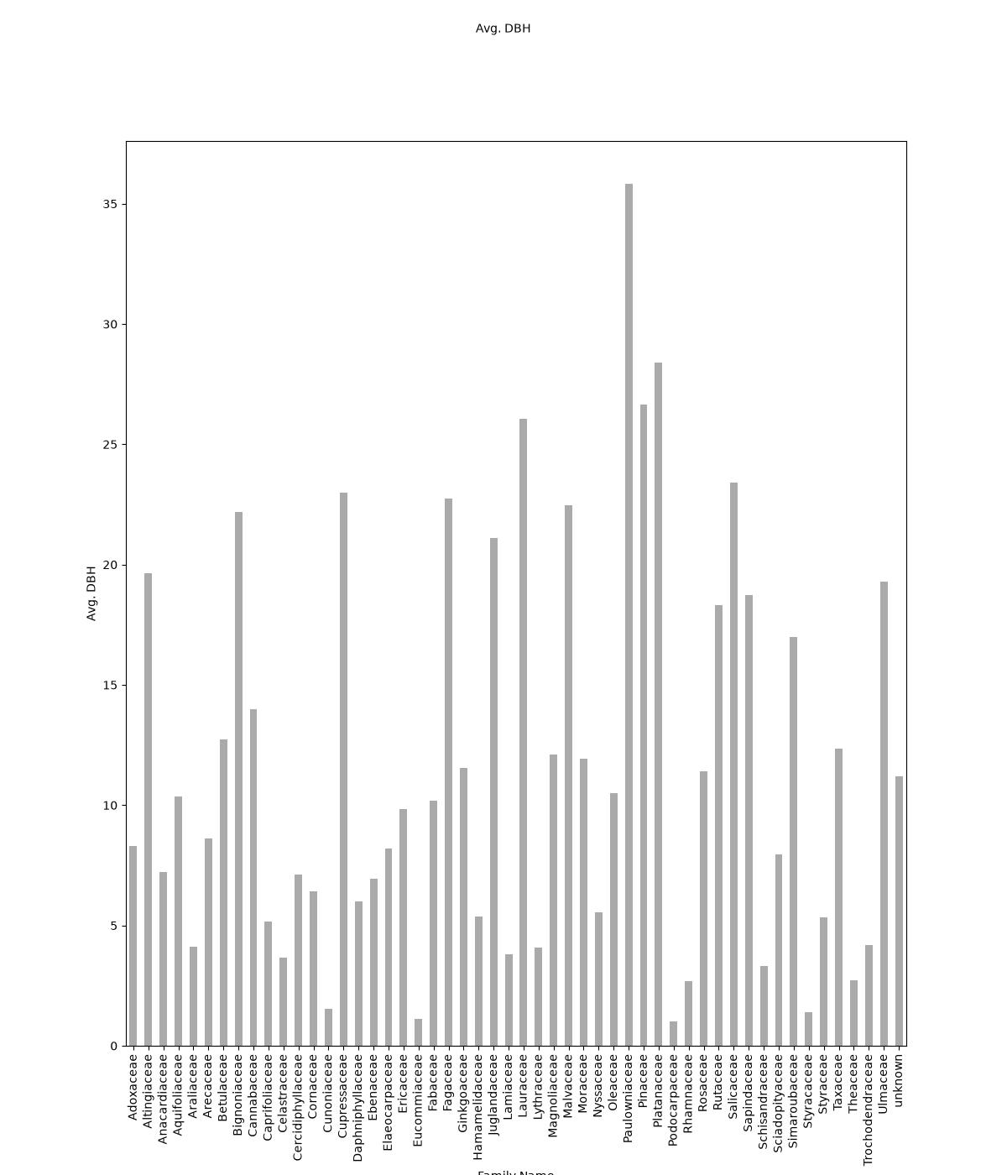
Bad Data Visualization Example
Bad example
What is wrong with this visualization?

Slide 12
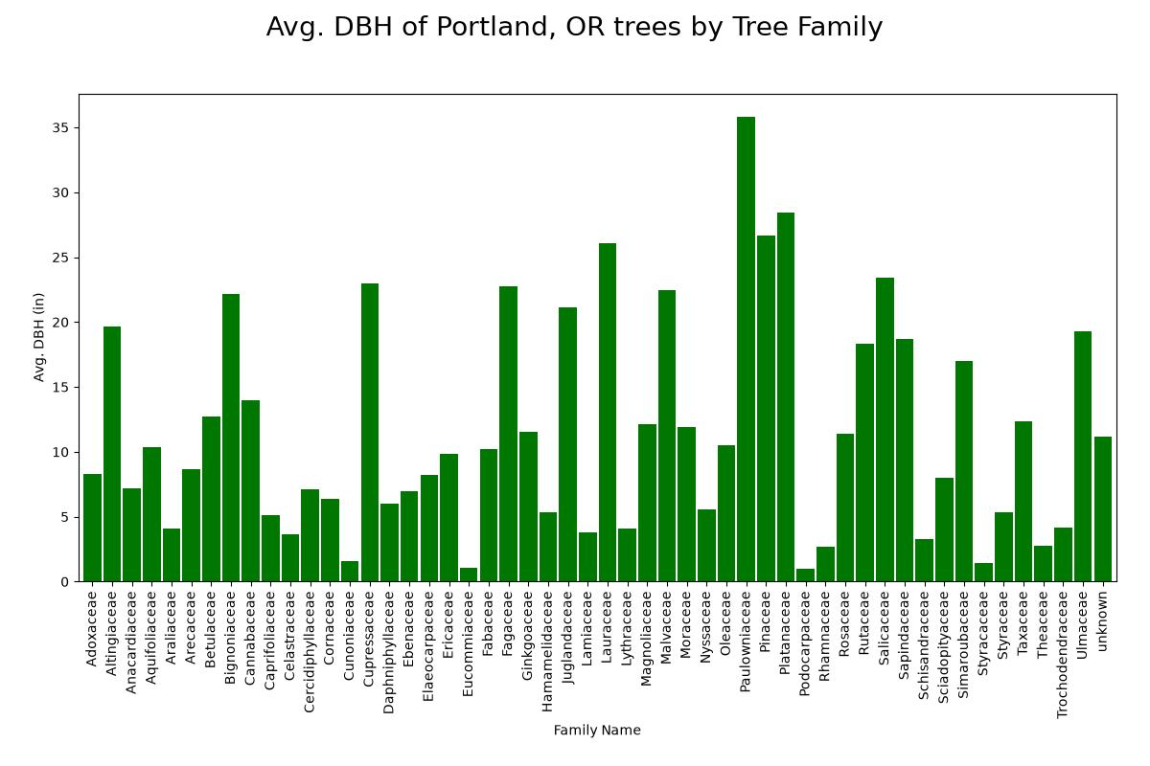
Bad Data Visualization Example
Improved example

Slide 13
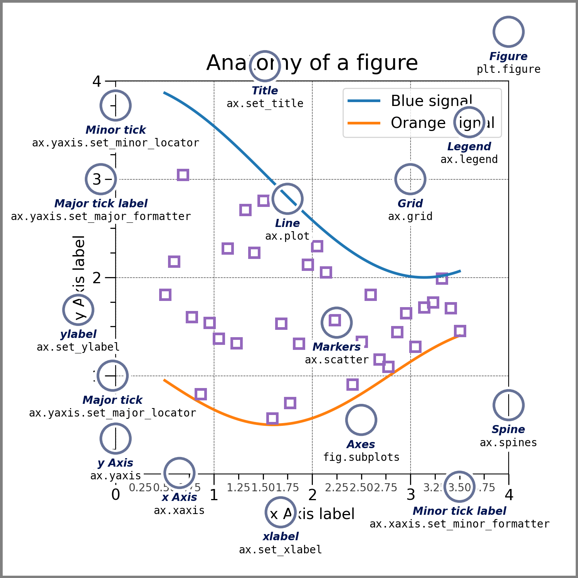
Reading Package Documentation: Matplotlib
Quick start
https://matplotlib.org/stable/users/explain/quick_start.html#parts-of-a-figure
Documentation
https://matplotlib.org/stable/api/index.html

Slide 14
Preparing for Data Visualization with Python
Know your data
Are there any issues with the data (errors, inconsistencies, missing values, etc.)? What can be learned from the data? How can the data be best represented in a visualization?
Process or clean data if necessary
Produce visualization
Refine visualization

Slide 15

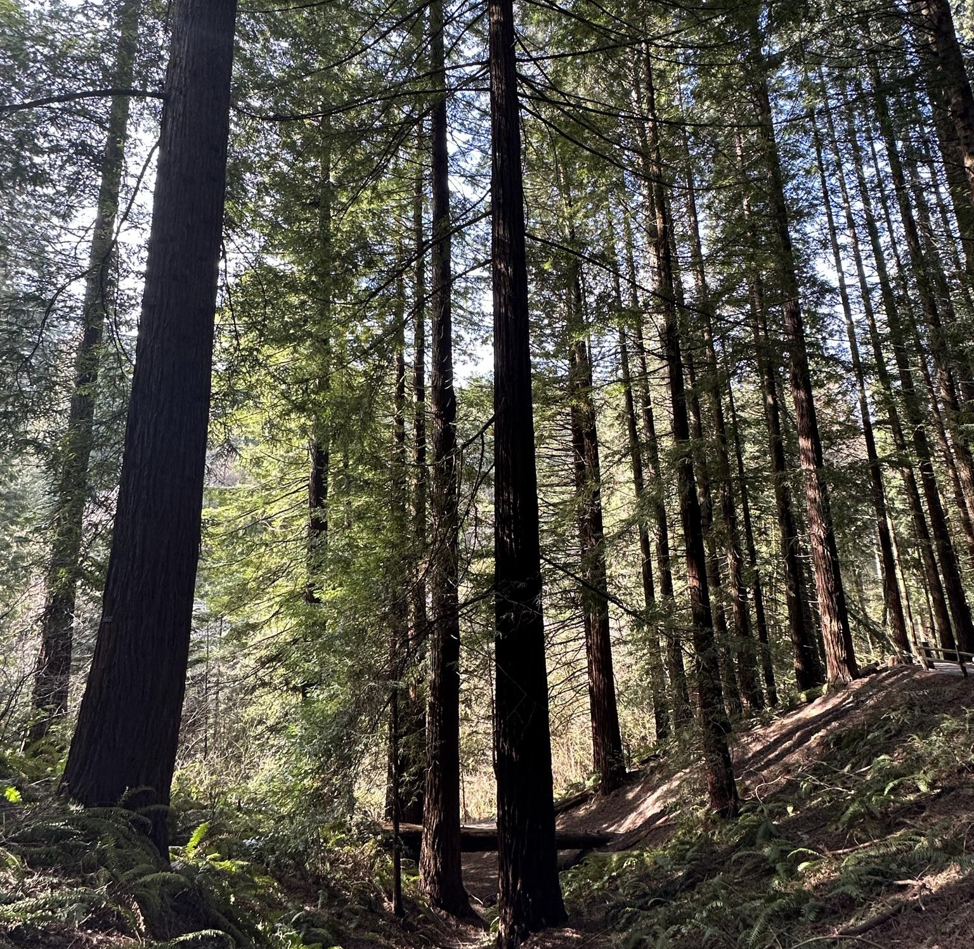
Datasets to Practice Visualizing (slide 1 of 3)
Data Source: Dive characteristics of Weddell seals 2014-2016
From the Texas Data Repository dataset at https://dataverse.tdl.org/file.xhtml?fileId=62725&datasetVersionId=1894
The publication related to this dataset is: Fuiman, L.A., T.M. Williams, and R.W. Davis. 2020. Homing tactics of Weddell seals in the Antarctic fast-ice environment. Marine Biology. (doi: 10.1007/s00227-020-03730-w)
sealdivesdf = pd.read_csv("https://dataverse.tdl.org/api/access/datafile/62725?gbrecs=true")
Data Source: Portland, Oregon parks tree inventory data
From https://gis-pdx.opendata.arcgis.com/datasets/PDX::parks-tree-inventory/about
treesdf = pd.read_csv("https://hub.arcgis.com/api/v3/datasets/15ae00ece1bf486a868c0f635d3acbfa_220/downloads/data?format=csv&spatialRefId=3857&where=1%3D1")

Slide 16
Datasets to Practice Visualizing (slide 2 of 3)
Data Source: Telco customer churn dataset
From https://github.com/IBM/telco-customer-churn-on-icp4d/tree/master
customerchurndf = pd.read_csv("https://raw.githubusercontent.com/IBM/telco-customer-churn-on-icp4d/refs/heads/master/data/Telco-Customer-Churn.csv")
Data Source: Single Band Raster from UAV Imagery Orthomosaic
singleimageband2 = {"bandname":"green", "cmap":"Greens", "url":"https://ut-austin.maps.arcgis.com/sharing/rest/content/items/21bfc72d87a844c8834db572bda24e58/data"}

Slide 17
Datasets to Practice Visualizing (slide 3 of 3)
National Household Education Surveys Program (NHES)
Parent and Family Involvement in Education (PFI)
Source Homepage: https://nces.ed.gov/nhes/dataproducts.asp#2019dp
Relevant Resources: https://nces.ed.gov/pubs2021/2021030rev.pdf (user guide)
edudf = pd.read_csv("https://nces.ed.gov/nhes/data/2019/pfi/pfi_pu_pert.csv")

Slide 18
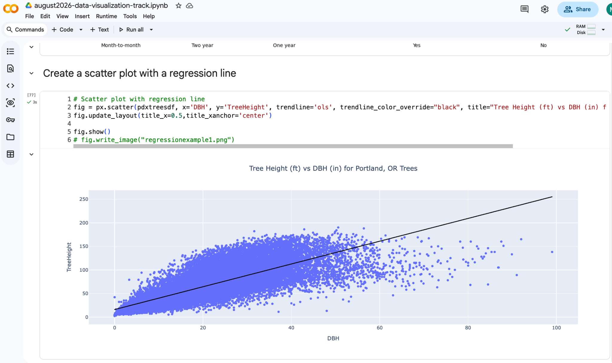
Visualizing Data Demo: Colab Notebook
Importing data visualization packages
Accessing data
Generating visualizations
Customizing figure properties
Please save a copy of this script to your drive so you can edit it
Link to publicly shared August 26 IPW Data Visualization Google Colab Notebook
https://bit.ly/datavis-colab-ipw-aug26

Slide 19
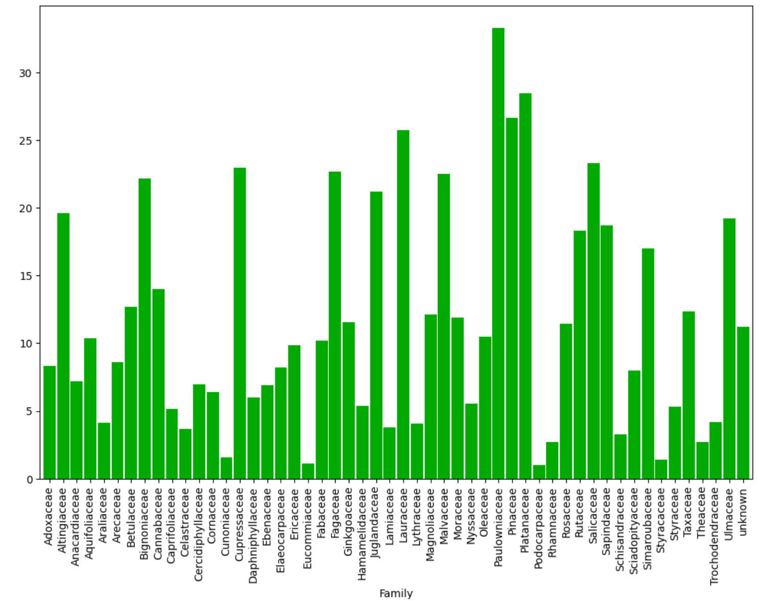
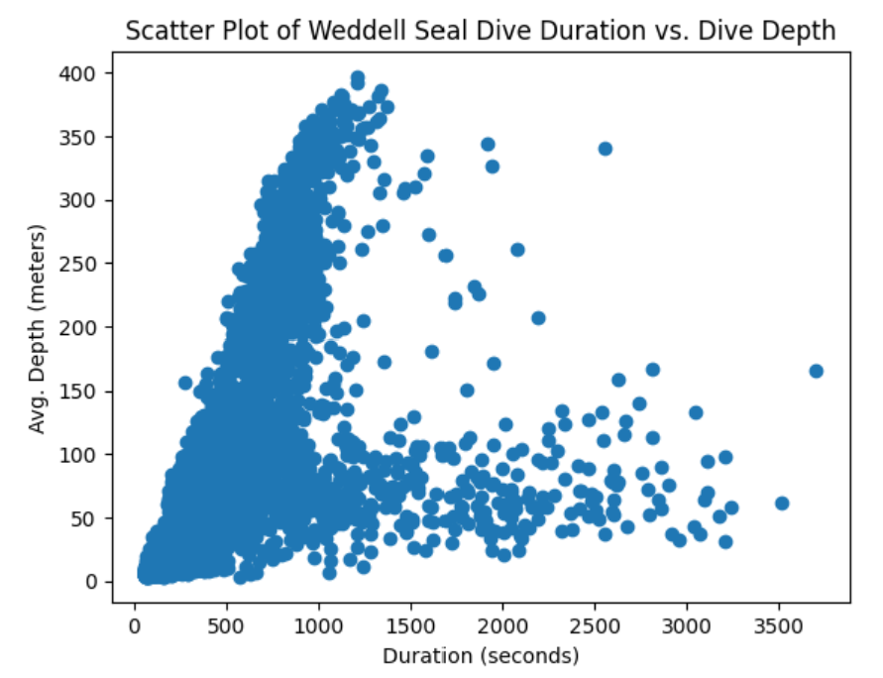
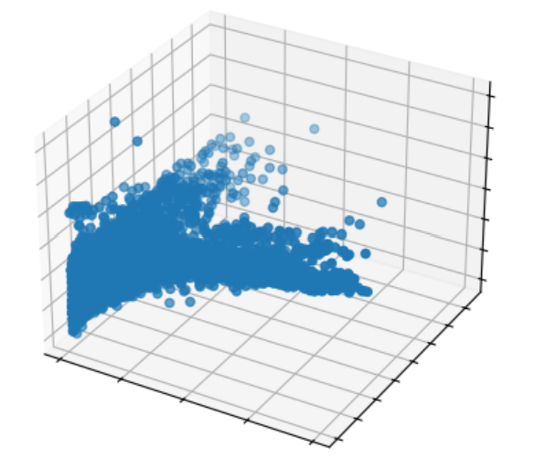
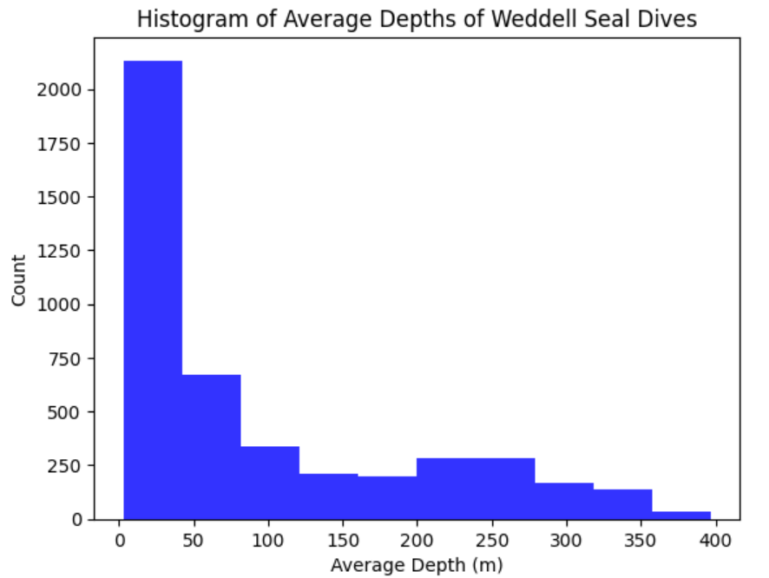
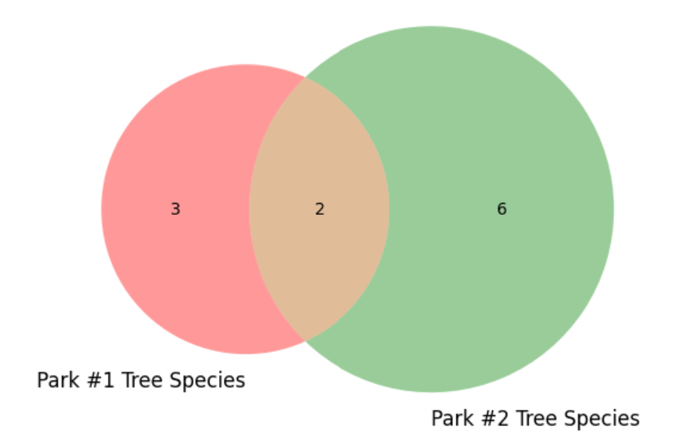
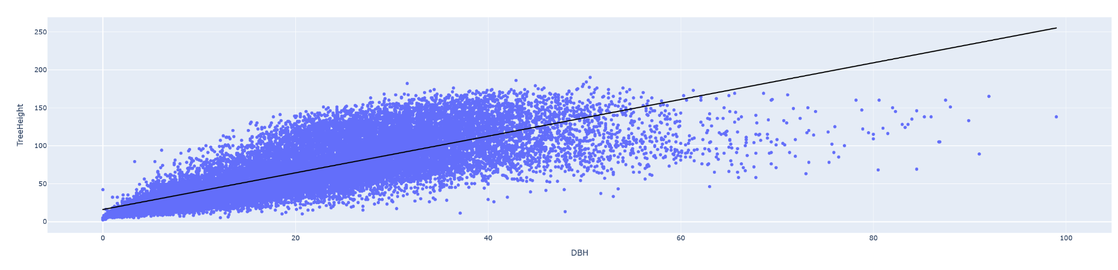
Visualizing Data Demo: Local Development
Installing new packages (remember to use virtual environment!)
Creating a variety of different chart types including pie charts, bar charts, and scatter plots
Comparing code for creating simple chart types with different visualization libraries
Reading package documentation to learn how to create and make adjustments to charts and figures

